Slide 1



UNIT 2
Lesson 6
What’s with you?
Part 2

Slide 2
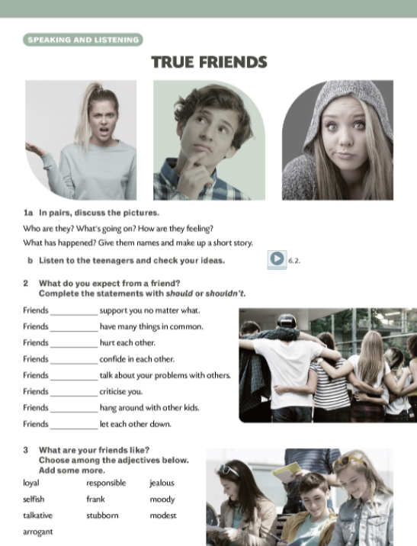
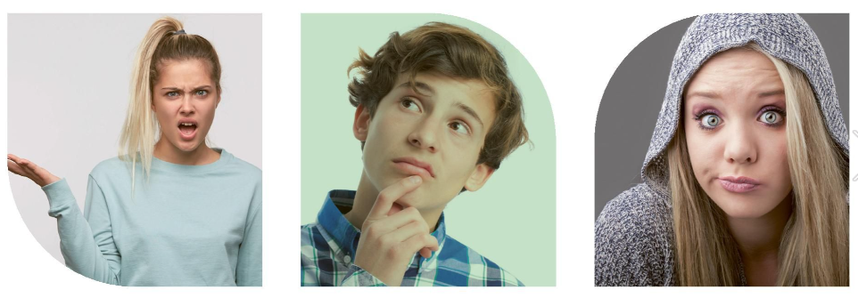
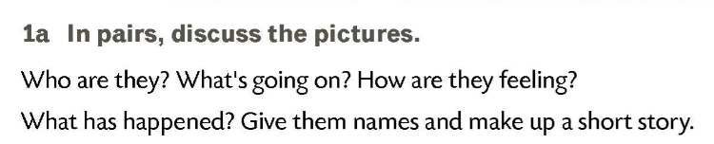



Slide 3
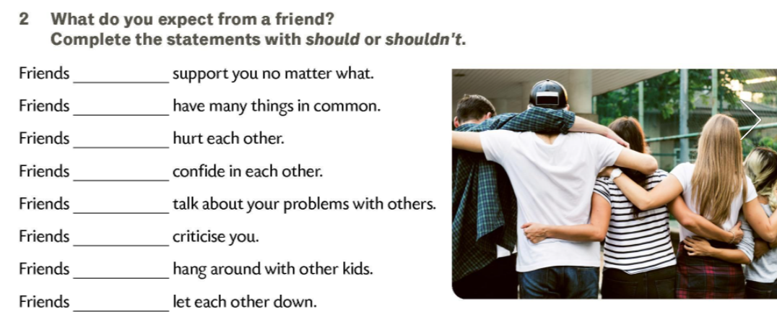
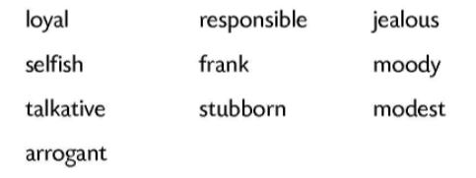
A pearson who speas honestly and says what he/she really thinks.
A person who has an obligation to do something, or has control over or care for someone, as part of one's job or role.
A person who is unhappy and angry because he/she wants something that someone else has.
A person who is often unfriendly because he/she feels angry or unhappy.
A person who cares only about himself/herself and not other people.
A person who always likes and supports someone or something, sometimes when other people do not.
A person who talks a lot.
A person who determines not to change his/her ideas, plans, etc, although other people want them to.
A person who doesn’t talk in a proud way about his/her skills or successes.
A person who believes that he/she is better or more important than other people.

Slide 4
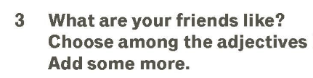
A person who always likes and supports someone or something, sometimes when other people do not.
A person who cares only about himself/herself and not other people.
A person who talks a lot.
A person who believes that he/she is better or more important than other people.
A person who has an obligation to do something, or has control over or care for someone, as part of one's job or role.
A pearson who speaks honestly and says what he/she really thinks.
A person who determines not to change his/her ideas, plans, etc, although other people want them to.
A person who is unhappy and angry because he/she wants something that someone else has.
A person who is often unfriendly because he/she feels angry or unhappy.
A person who doesn’t talk in a proud way about his/her skills or successes.
LOYAL
SELFISH
TALKATIVE
ARROGANT
RESPONSIBLE
FRANK
STUBBORN
JEALOUS
MOODY
MODEST

Slide 5
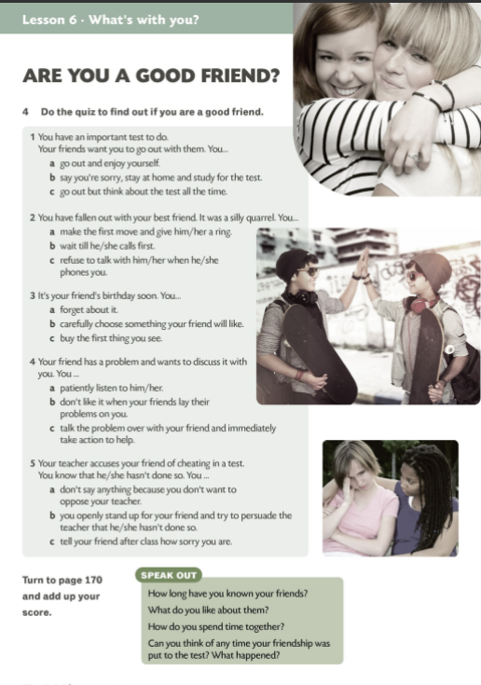
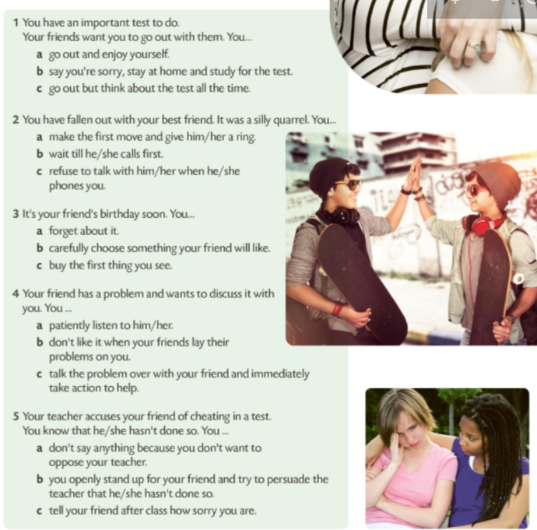
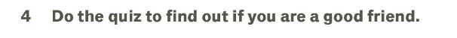
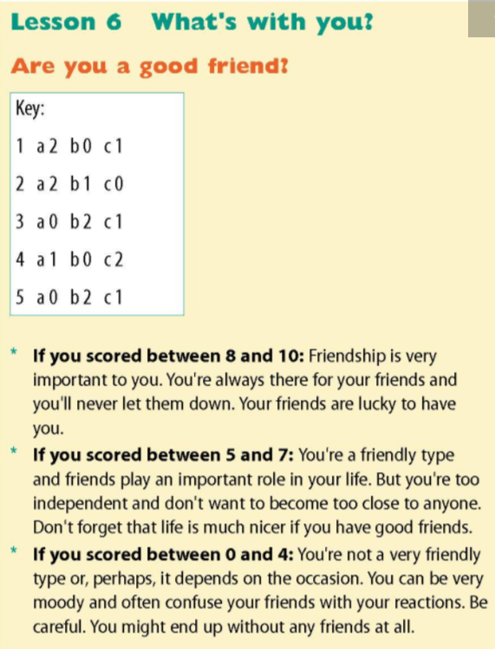
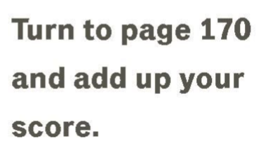
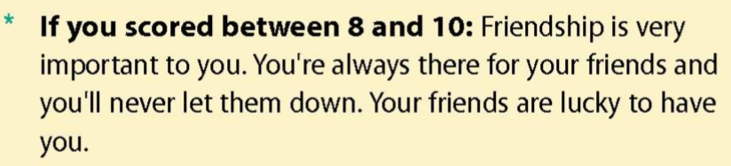
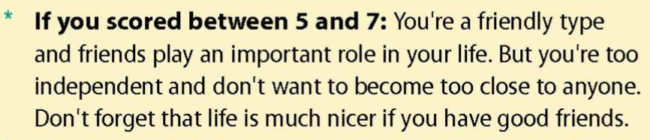
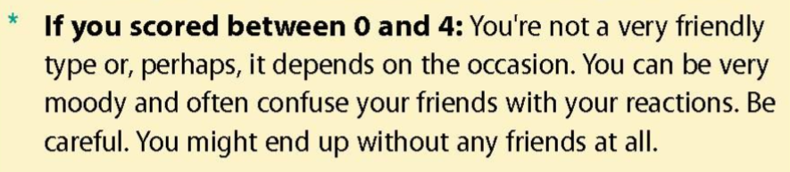

Slide 6
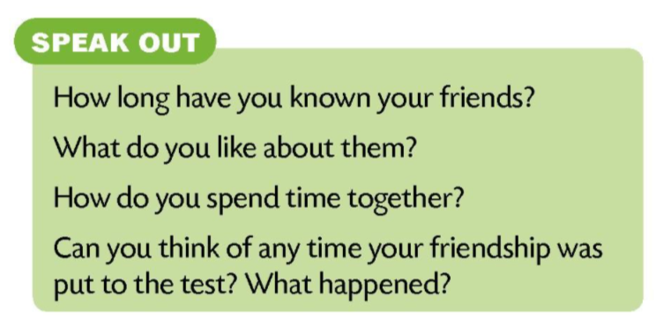
Have a class discussion. Use the questions in the Speak Out task.
Danny has a crush on Pam. He keeps thinking about her all the time. He has asked her out on a date. It wasn’t easy to do but he’s happy now. This weekend they are going to the cinema together.
To have a crush on means ________________________________________
To ask someone out on a date means ________________________________
Sally is unhappy. She has fallen out with Jane. They’ve been friends for years and now Jane doesn’t want to go out with her. She doesn’t want to talk to her at all. The worst thing of all is that they have fallen out over some funny and stupid thing.
To fall out with someone means __________________________________
netko ti se sviđa / biti zaljubljen u nekoga
posvađati se s nekim
pozvati nekoga van

Slide 7
Tom is Harry’s best friend. Harry can trust him and he knows that Tom will never let him down. Tom has proved that many times. Once the teacher accused Harry of copying somebody else’s essay. Tom stood up for him and helped him persuade the teacher that he hadn’t done that and that he’d written the essay.
To let down a friend means _______________________________________
To stand up for a friend means _____________________________________
Although Terry and Sally are good friends, they often have arguments. Sometimes they get so angry at each other that they don’t speak for days. However, they always make up and everything gets back to normal.
To make up with someone means ________________________________
pomiriti se s nekim
razočarati
zauzeti se za prijatelja
This weekend will be awful for me. I need to finish my science project. If I don’t hand it in on Monday, I’ll get an F. That’s not all. Mr. Lewis will quiz me. The problem is I haven’t been working hard recently. I haven’t studied for some time so I have fallen behind. A lot. I don’t think I can catch up. Too much stuff, too little time.
To fall behind means to ________________________________________
To catch up means to ______________________________________
zaostati
nadoknaditi

Slide 8
I need to study hard. I need good grades. I’d like to enroll in the best school in town. It won’t be easy but I can do it. I need to go to a good secondary school because I want to go to university.
To enrol in means ______________________________________
upisati se
Darren and Leila aren’t boyfriend and girlfriend any longer. Leila dumped him. It’s not because she has fallen in love with someone else. No. But the funny thing is they still hang out together. They go to the cinema together, they meet in the playground and talk for hours. It’s funny, isn’t it?
To hang out means ______________________________________
družiti se s nekim / provoditi vrijeme s nekim

